Slide 1

Hysterectomy
Presented By: Ms. Sujata Walode, Tutor, MGM SBSA

Slide 2
Contents
What is hysterectomy
Indications
Types of hysterectomy
Total
Partial
Radical
Total hysterectomy with bilateral salpingo-oopherectomy
Types according to route
Vaginal
Abdominal
Laparoscopic
  LAVH
  LSH
  TLH
Complications

Slide 3
What is Hysterectomy?
 Hysterectomy is the surgical removal of the uterus, it may also involve removal of the cervix, ovaries, fallopian tubes and other surrounding structures.
 It is a common operation carried out to treat conditions of the female reproductive system.
 Hysterectomy is a major surgical procedure that has risks and benefits, and affects a woman's hormonal balance and overall health for the rest of her life.
 Because of this, hysterectomy is normally recommended as a last option to remedy certain uterine conditions.

Slide 4

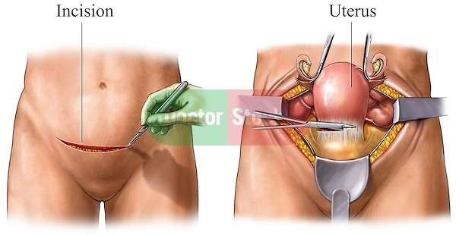

Slide 5
Indications Of Hysterectomy:
Fibroids
Adenomyosis
Endometriosis
Dysfunctional Uterine Bleeding
Cervical Cancer
Rupture or Injury to Uterus
Uterine Prolapse
Uterine Cancer
Ovarian Cancer

Slide 6
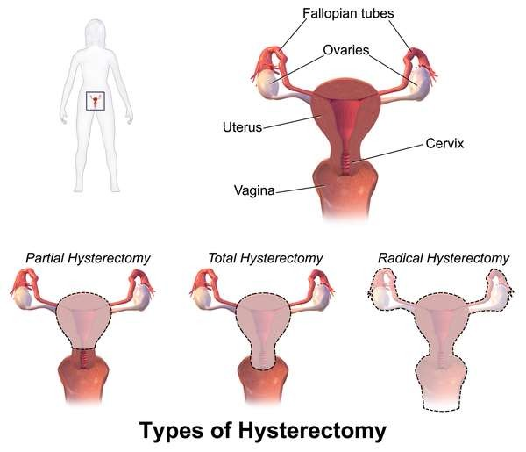
Types Of Hysterectomy:
Total Hysterectomy
Partial Hysterectomy
Radical Hysterectomy

Slide 7
Types Of Hysterectomy
1.
Total hysterectomy:
 It is the surgical removal of the uterus and the cervix, which is the lower "neck" of the uterus that opens into the vagina.
 A Total Hysterectomy is necessary when the cervix needs to be removed.
 For example: In case of Cervical cancer.
2.
Partial hysterectomy:

In Partial Hysterectomy (also known as Supracervical or subtotal hysterectomy), the uterus is removed, but cervix is not removed.
3.
Radical hysterectomy:
 It is the removal of uterus, cervix, ovaries, structures that support the uterus, and sometimes the lymph nodes.
 A radical hysterectomy may be done to treat endometriosis or cancer of the uterus, ovaries, or cervix.

Slide 8
Total hysterectomy with bilateral salpingo- oophorectomy:
 A total hysterectomy with bilateral salpingo- oophorectomy is a hysterectomy that involves removal of:
 Fallopian tubes (salpingectomy) and
 Ovaries (oophorectomy)
 Ovaries should be removed if there's a significant risk of ovarian cancer.

Slide 9
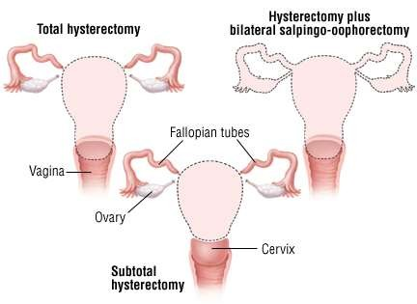

Slide 10
Types According to Route:
Vaginal
Abdominal
Laproscopic

Slide 11
1. Vaginal Hysterectomy
 During a vaginal hysterectomy, the uterus and cervix are removed through an incision made in the top of vagina.
 Surgical instruments are inserted into the vagina to detach the uterus from ligaments.
 A vaginal hysterectomy can be done:
 To remove small uterine fibroids.
 When the uterus is of normal size.
 A vaginal hysterectomy is usually preferred over an abdominal hysterectomy, because it is less invasive and the recovery time also tends to be quicker.

Slide 12
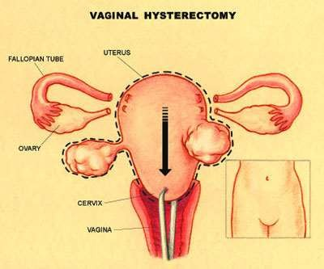

Slide 13
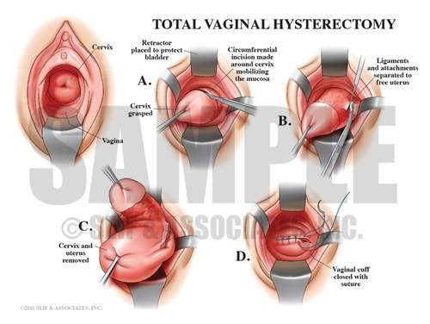

Slide 14
2. Abdominal hysterectomy
 During an abdominal hysterectomy, an incision will be made in the
abdomen. It will either be horizontally or vertically.
 An abdominal hysterectomy may be recommended when:
 Uterus is very large.
 Uterine fibroids are larger than 20 cm (across or located around blood vessels).
 Cancer of the uterus, ovaries, or cervix.
 An ovarian growth (mass).
 Endometriosis.

Slide 15
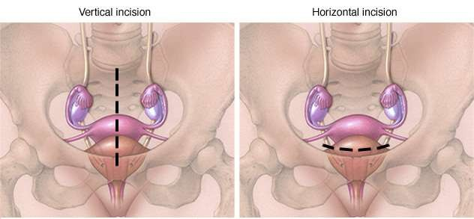

Slide 16
3. Laparoscopic hysterectomy
Nowadays, a laparoscopic hysterectomy is the preferred treatment method for removing the organs and surrounding tissues of the reproductive system.
Laparoscopically assisted vaginal hysterectomy (LAVH)
Laparoscopic supracervical hysterectomy (LSH)
Total laparoscopic hysterectomy (TLH)

Slide 17
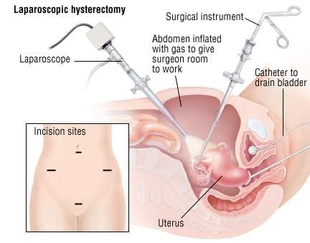

Slide 18
A. Laparoscopically-assisted Vaginal Hysterectomy (LAVH)
 During the procedure, lighted tube and scope (laparoscope) and surgical instruments inserted through a vaginal incision and one or more small abdominal incisions.
 The ovaries and other organs may removed.
 The uterus is removed through the vagina.
 It is done when:
 Uterine fibroids are small to moderate in size.
 Uterus is slightly larger than normal.
 Endometriosis.

Slide 19
B. Supracervical Hysterectomy (LSH)
 Laparoscopic supracervical hysterectomy is done by inserting a laparoscope and surgical instruments through several small abdominal incisions.
 The uterus is removed in small pieces through one of the incisions and the cervix is left intact.
 This is also known as subtotal or partial hysterectomy.
 This type of procedure usually causes
minimal blood loss and pain. LSH can be done:
 To remove uterine fibroids of any size.
 To remove a uterus of any size.

Slide 20
C. Total Laparoscopic Hysterectomy (TLH)
 The total laparoscopic hysterectomy is done by inserting a laparoscope and surgical instruments through several small incisions in the abdomen.
 The uterus and the cervix are removed in small pieces through one of the incisions.
 TLH can be done when:
 To remove uterine fibroids, which are small to moderate in size.
 There is no chance of uterine or ovarian cancer.

Slide 21
Complications Of Hysterectomy
 Sepsis
 Shock
 Trauma to adjacent organs:
 Ureters
 Bladder or Bowel
 Urine Retention
 Cystitis
 Vaginal wall Prolapse
 Hemorrhage
 Weakening of Pelvic muscles
 Osteoporosis
 Chances of CVS increases

