Slide 1




Presented By: Sujata Walode, Tutor, MGM SBSA

Slide 2


INTRODUCTION
Breathing circuits connects the patient to the anaesthesia machine through endotracheal tube or mask.
A pathway in which volatile agents and oxygen is delivered and co2 is removed.
These are divide into: Open system
Semi-closed system
Closed system

Slide 3

OPEN SYSTEM
This is now the obsolete technique .
Inhalational agent is directly poured over patients mouth and nostril.
A mask called a Schimmelbush mask is placed over patient mouth over which a layer of gauge piece is put and inhalational agent (especially ether) is poured in drops (open drop anaesthesia)

Slide 4
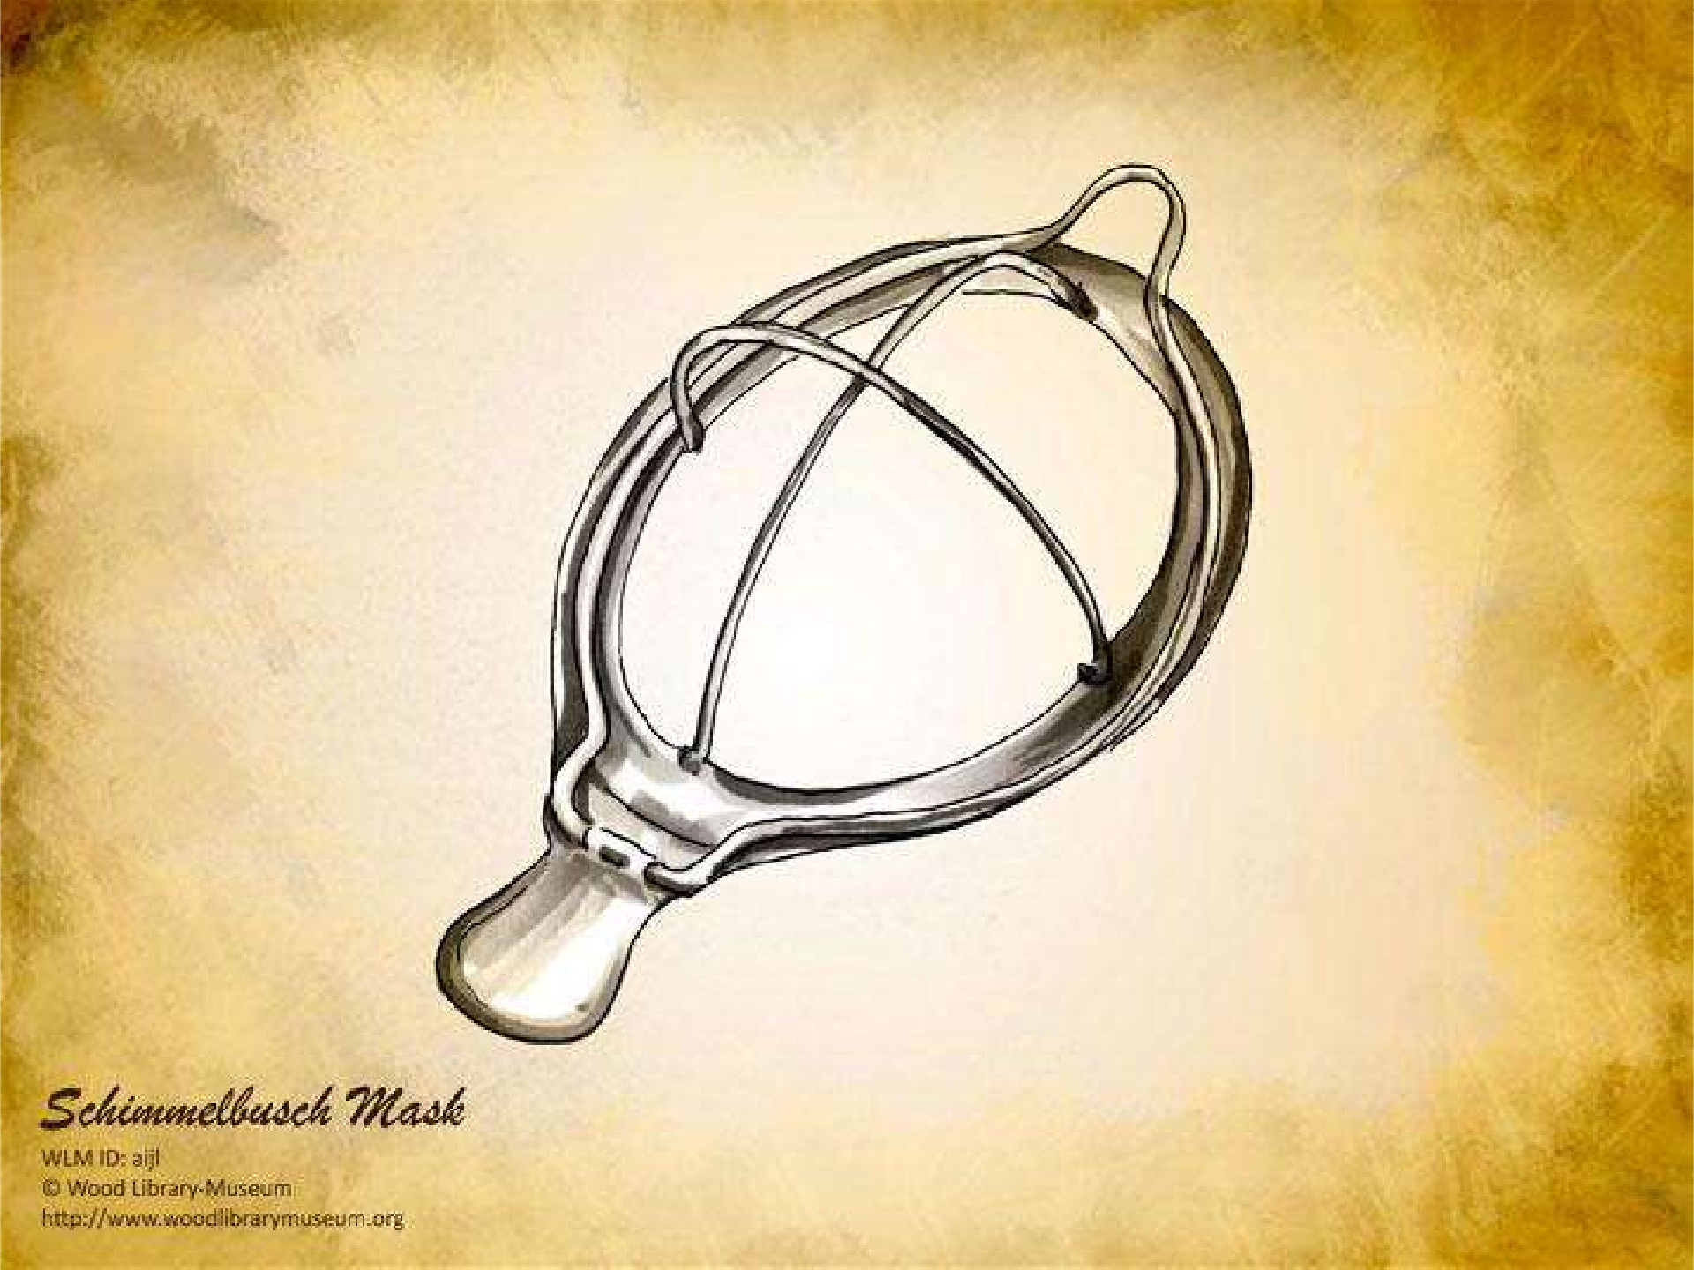


Slide 5



Slide 6

Disadvantages
There is a lot of wastage and uncontrollable pollution.
Accurate concentration can not be delivered.
Time consuming induction.
Gauge piece may become sodden and increases the dead space
Fire hazard
Skin and eye irritation
If a folded towel is placed over schimmelbusch mask to prevent early escape of inhalation agent it constitutes semi open system.
Other gases which can be given by open method are chloroform and ethyl chloride.

Slide 7

SEMICLOSED CIRCUITS
These circuits were described by MAPELSON therefore also called as Mapelson circuits.
These are divided into six types:
Type A, B , C, D, E , F
Because of similarity in characteristics some authors have classified them in 3 groups- A, BC, DEF

Slide 8
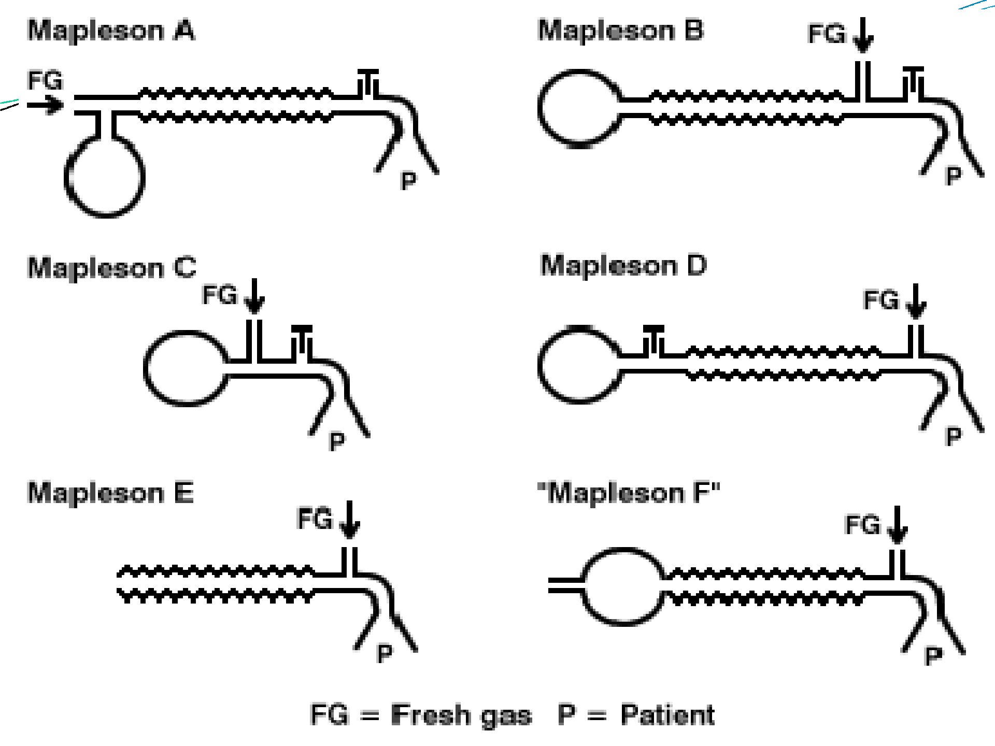


Slide 9

Type A
Also called as Magill circuit.
Fresh gases coming from machine reaches the patient.
Exhaled gases from patient are mostly exhaled from pressure relief valve but some of the gases go back in tubing(that is why these circuits are called semi closed circuits)
The expiratory gases which has gone back in the tubing may be reinhaled by the patient in next breath. This is called as rebreathing

Slide 10

APL valve is at the patients end.
Fresh gas flow should be equal to minute volume(70ml/kg/min).
Circuit of choice for spontaneous ventilation.
It is not suitable for use with children of less than 25- 30 kg body weight. This is because of increased dead space.
It should not be used in controlled ventilation

Slide 11
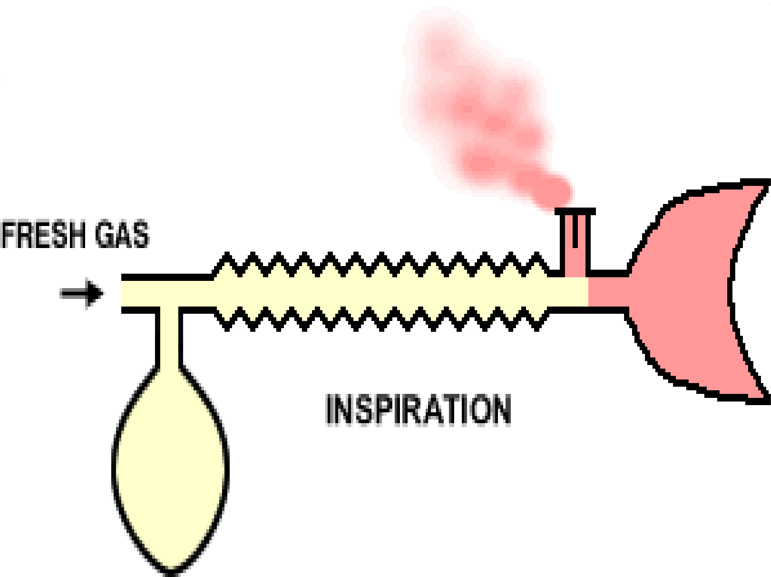


Slide 12

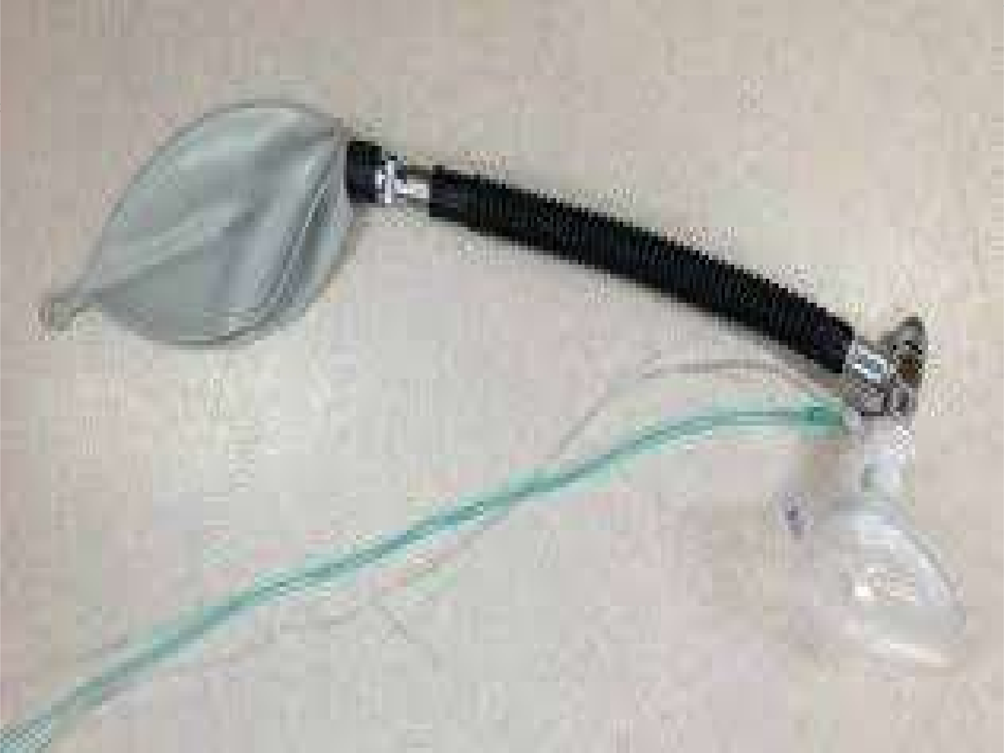
Type B
Fresh gas flow inlet brought near APL valve
It does not offer any advantage, so is no more used.
Functionally almost equally efficient for spontaneous and controlled ventilation

Slide 13

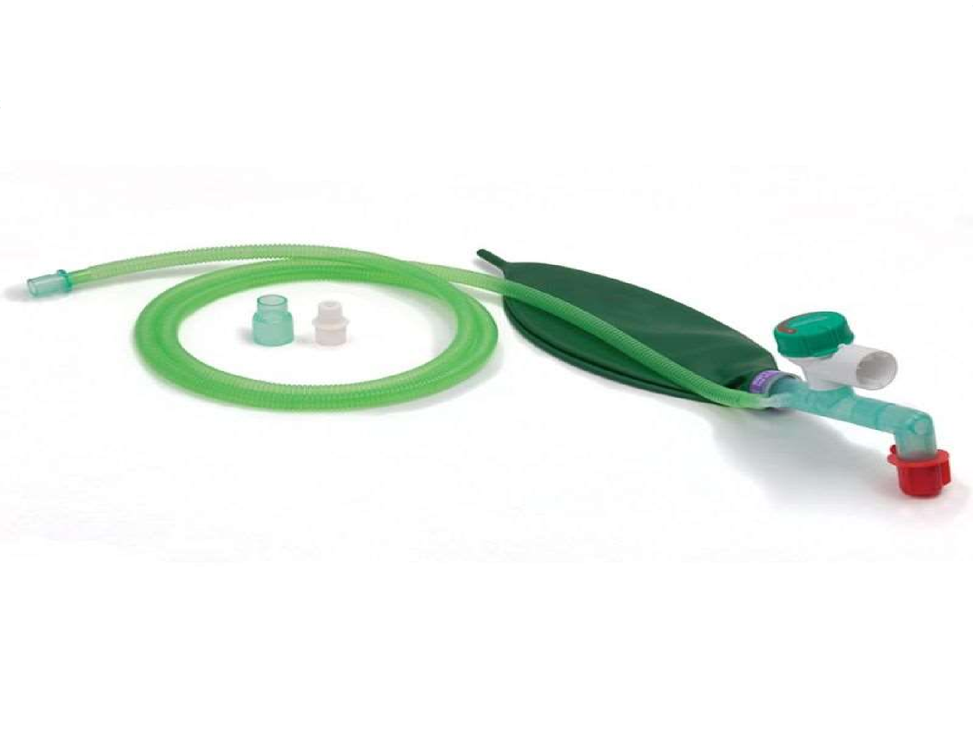
Type C
Corrugated tubing is shortened
Also called as Water`s circuit.
Functionally almost equally efficient for spontaneous and controlled ventilation
Offers no advantage and is no more used

Slide 14

Type D
APL valve is brought near the bag
Modification was made by Bain that it why it is also called as Bain`s circuit.
Bain made it a coaxial system in which a fresh gases are delivered through a inner tube so that mixing of fresh gases and exhaled gases can be minimized.
Bain`s circuit is most commonly used semiclosed circuit in anaesthesia
Bain`s circuit is a circuit of choice for controlled ventilation

Slide 15
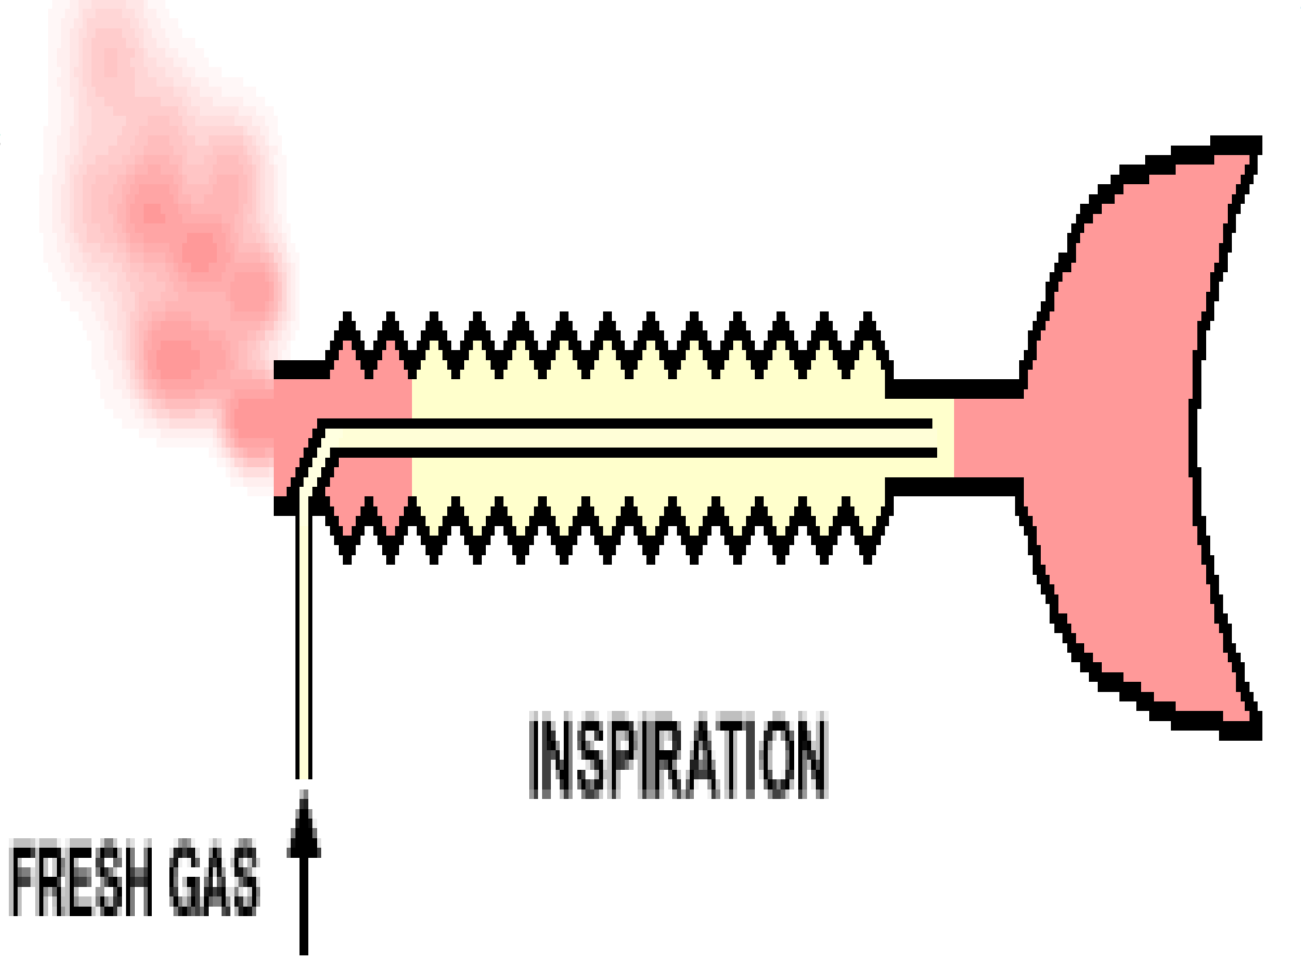


Slide 16

Fresh gas flow for controlled ventilation is 1.6 times of minute ventilation at normal respiratory rates(12 breaths/min)
70-100 ml/kg/min (which is equal to minute ventilation) if respiratory rate is increased to 16 breaths/min
Bain circuit can be used for spontaneous ventilation but fresh gas requirement is higher ,2.5 times of minute ventilation

Slide 17

Advantages of Bain circuit
Light weight
Corrugated tube is long(1.8 meter), so good for head and neck surgeries where anaesthetist is away from patient and there is less fire hazard as exhaled gases escapes away from machine.
Less resistant
Sterilization is easy
Outer tube is transparent

Slide 18
Disadvantages
 Inner tube may become folded or kinked causing obstruction or may get disconnected.

Slide 19

TYPE E
It is Ayer`s T piece with corrugated tubing.
Paediatric circuit.
It does not have breathing bag, so it is not a complete circuit.
It is only for spontaneous ventilation as it does not contain breathing bag.
It can be used for controlled ventilation by occluding the expiratory limb .

Slide 20

TYPE F
It is a modification of Ayer`s T piece
Most commonly used semi closed circuit used in children <6years of age or less than 20 kg.
Fresh gas flow is similar to Bain i.e. 1.6 times of minute volume for controlled ventilation. and 2.5 times of minute volume for spontaneous ventilation
Type E and Type F circuits are valve less to decrease the resistance
F circuits have holes in the tail of bag but valve may be present in some type of F circuits

Slide 21

CLOSED CIRCUIT
In human being`s this technique was used by Water`s in 1923
In this system no gas escapes to atmosphere( that`s why called as closed circuit) ,
Exhaled gases after absorption of carbon dioxide are re-inhaled by the patient .
Same gases can be re-used very low flows are sufficient therefore anaesthesia given with closed circuit is called as low flow anaesthesia

Slide 22

 There are two types of closed circuits:
1. CIRCLE SYSTEM: commonly used
2. TO & FRO SYSTEM; no more used

Slide 23

CIRCLE SYSTEM
The exhaled gases of patient through expiratory limb reaches sodalime canister containing sodalime which absorbs carbon dioxide and the same gases can be reused. Since the same gases are in circulation they are called as circle system.
The advantage is that it is very economical ( same gases and inhalational agents can be reused)
The canister are made up of transparent plastic material and have capacity of 4 lb

Slide 24

CARBON DIOXIDE ABSORBANT
SODALIME:
Soda lime is the most commonly used carbon dioxide absorbent.
COMPOSITION OF SODALIME :
Ca(OH)2
NaOH
: 94%
: 5%
: 1%
KOH
Indicator
Silica (to prevent dust formation)

Slide 25

COLOUR INDICATORS OF SODALIME
 There are many colour indicators used with sodalime
Ethyl violet: which is white when fresh and becomes purple on exhaustion.
Phenolphthalein: white when fresh and becomes pink on exhaustion
Clayton: red when fresh and becomes yellow on exhaustion
Durasorb : which is pink on fresh and becomes white on exhaustion. Most commonly used and is a good quality sodalime with prolonged life.
SO ,Colour change of indicator is one of the signs of exhaustion of sodalime

Slide 26

Other signs of exhaustion
Tachycardia
Hypertension
Increased oozing from wound site
Increased end tidal CO2 on capnography

Slide 27

Factors affecting carbon dioxide absorption in closed circuit
Freshness of sodalime: fresh absorbent has better carbon-dioxide absorbing capacity
Tidal volume of patient: large tidal volume will pass through canister without CO2 being absorbed
High flow : high flows allows less time for CO2 absorption
Dead space
Inadequate filling of sodalime

Slide 28
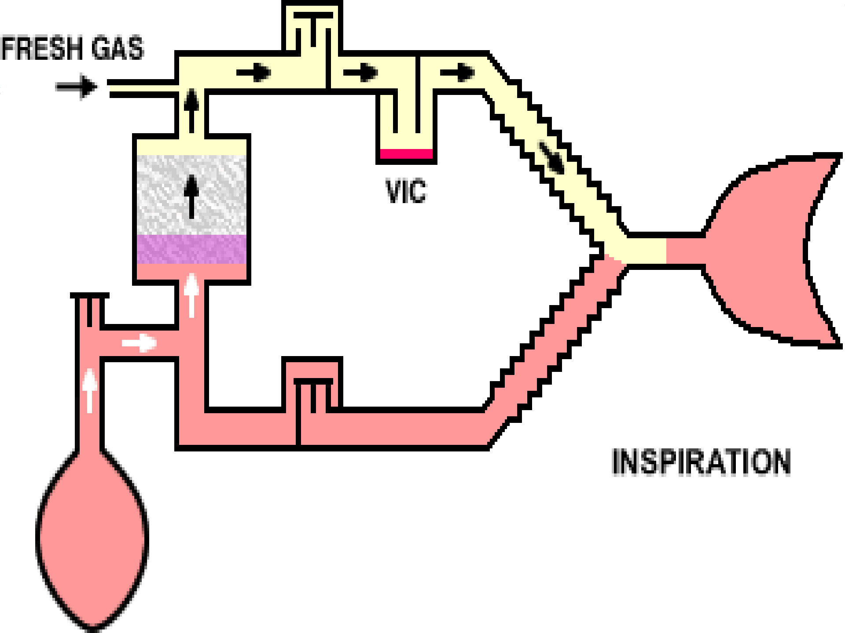


Slide 29



